Slide 1


ANGULAR
Presented By
Ananthi V

Slide 2
AGENDA
Introduction of Angular
Why Angular is most powerful?
Angular Architechture
Explanation of Angular Building Blocks
Advantages of Angular
Limitations in Angular

Slide 3
ANGULAR - INTRODUCTION
Angular is an open-source, powerful front end framework written in TypeScript.
primary purpose is to develop "Single-Page Application"(SPA- The whole page is not reloaded every time ,only the content will be change).
It enables users to create large applications in a maintainable manner.
Angular also provides testing tools (e2e,Karma,Jasmine etc.),so we can done the testing process through these tools.

Slide 4
WHY ANGULAR?
Angular framework provides testing tools, design patterns to build your project in a maintainable way.
Angular helps to build interactive and dynamic single page applications (SPAs) with its compelling features including templating, two-way binding, directives, RESTful API handling, dependency injection, Lazy Loading etc.
In Angular ,we use TypeScript(Strongly Typed) language so we can find errors while compilation.

Slide 5
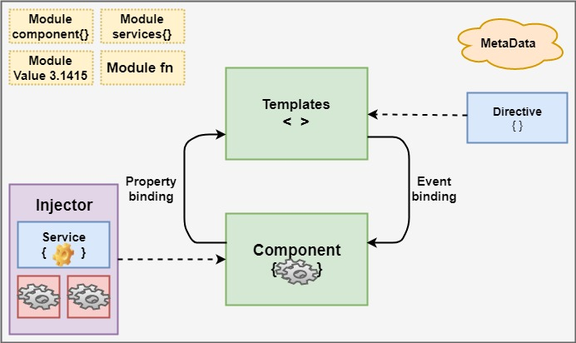
ARCHITECHTURE OF ANGULAR

Slide 6
BUILDING BLOCKS OF ANGULAR
1.Modules : An Angular app has a root module, named App Module, which provides the bootstrap mechanism to launch the application.
2.Components: Components are reusable codes in Angular. It reduces the bundle size of full angular application.
3.DataBinding: Communication between component file and template file,we can achieve databinding through Event Binding and Property Binding.

Slide 7
BUILDING BLOCKS OF ANGULAR
4. Metadata: It is used to decorate the class so that it can configure the expected behavior of a class.
5. Services: When you have data or logic that isn’t associated with the view but has to be shared across components, a service class is created. The class is always associated with the @Injectable decorator.
6. Dependency Injection: It allows users to write modules and services and inject them where ever they required.

Slide 8
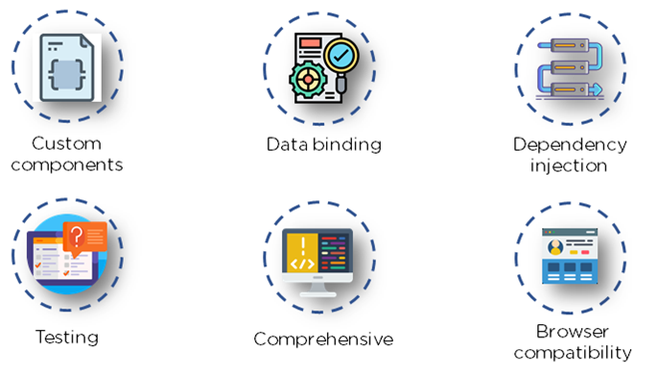
ADVANTAGES OF ANGULAR

Slide 9
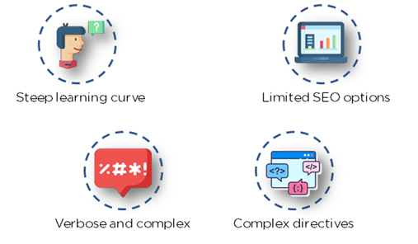
LIMITATIONS OF ANGULAR

Slide 10


Slide 11


